Slide 1

Computer &
English
IDR
Jayan Sunil | VIII - Colorado

Slide 2

Computer IDR
3

Slide 3
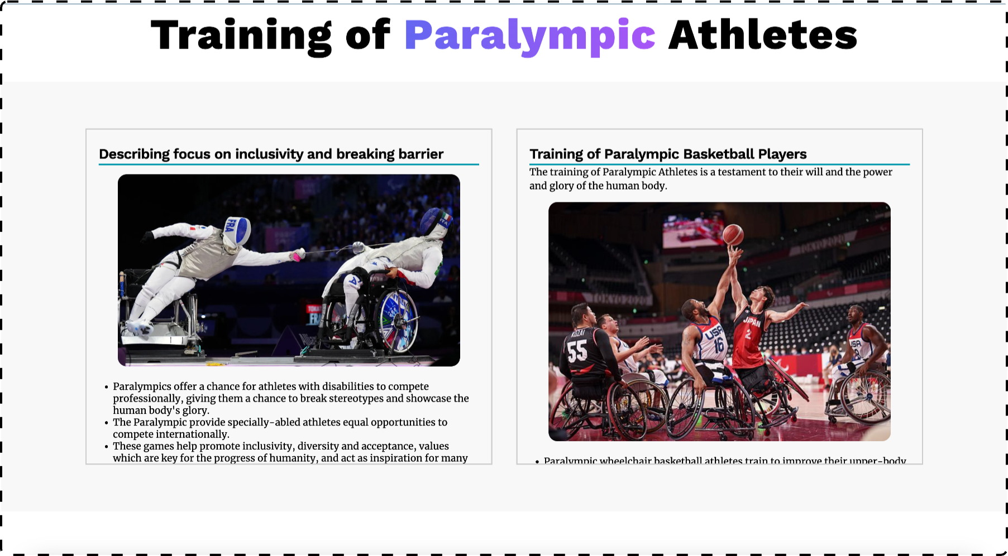
Screenshot 1

Slide 4
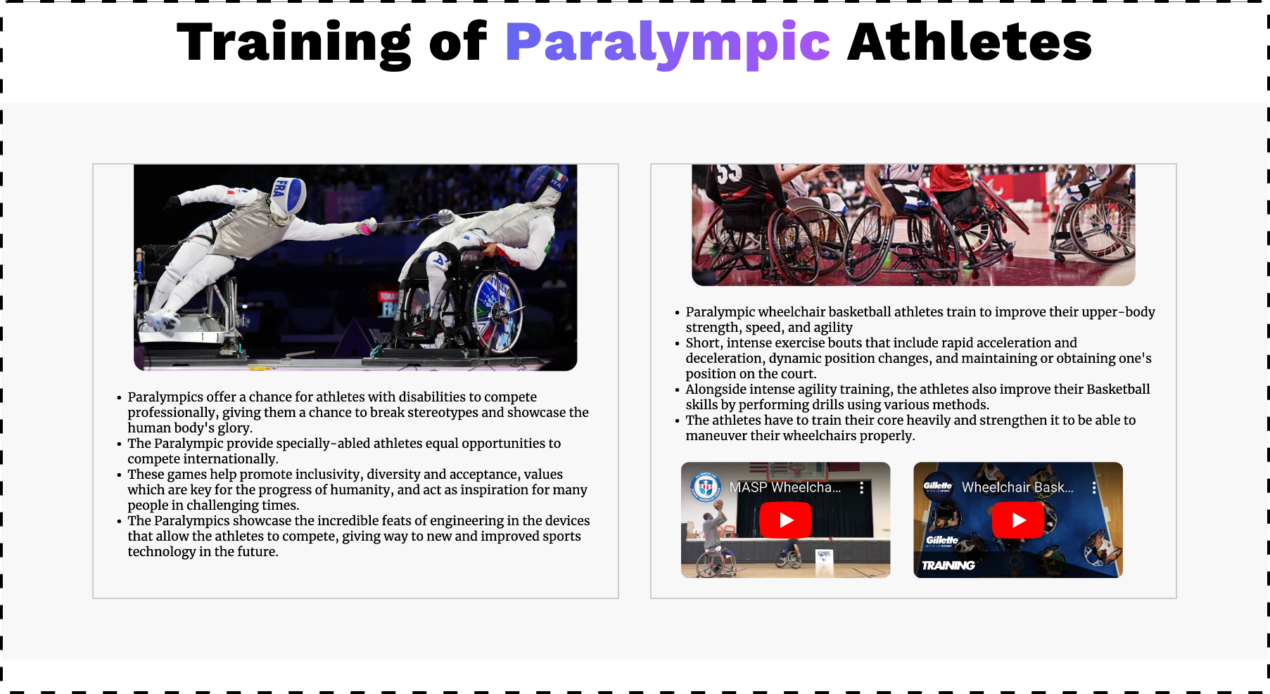
Screenshot 2

Slide 5
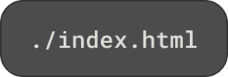


Slide 6

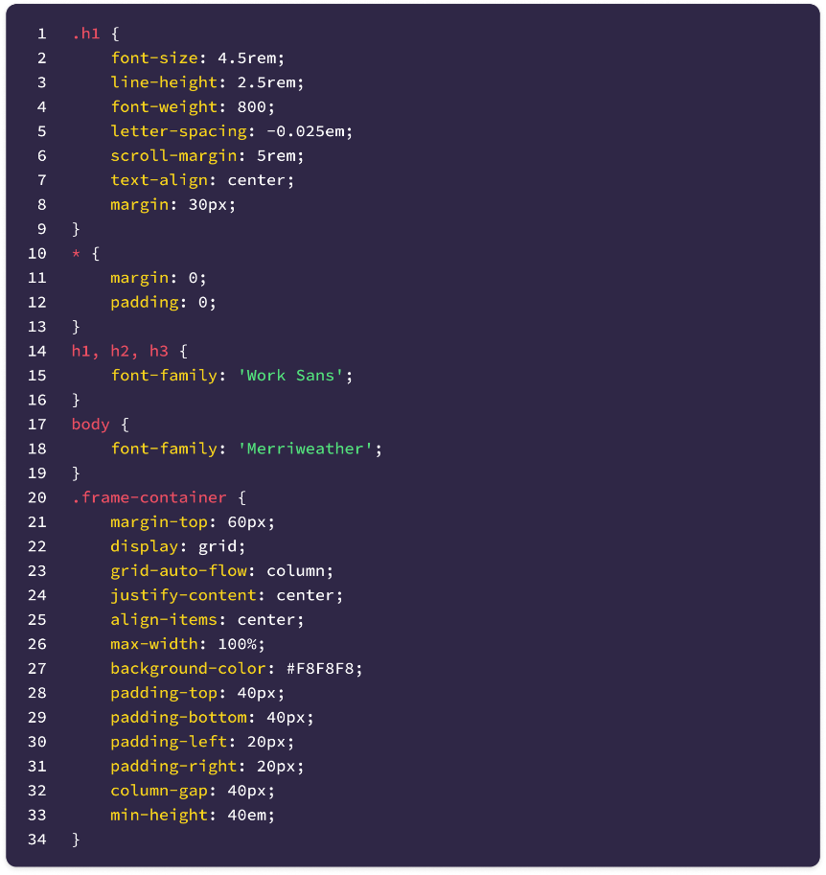
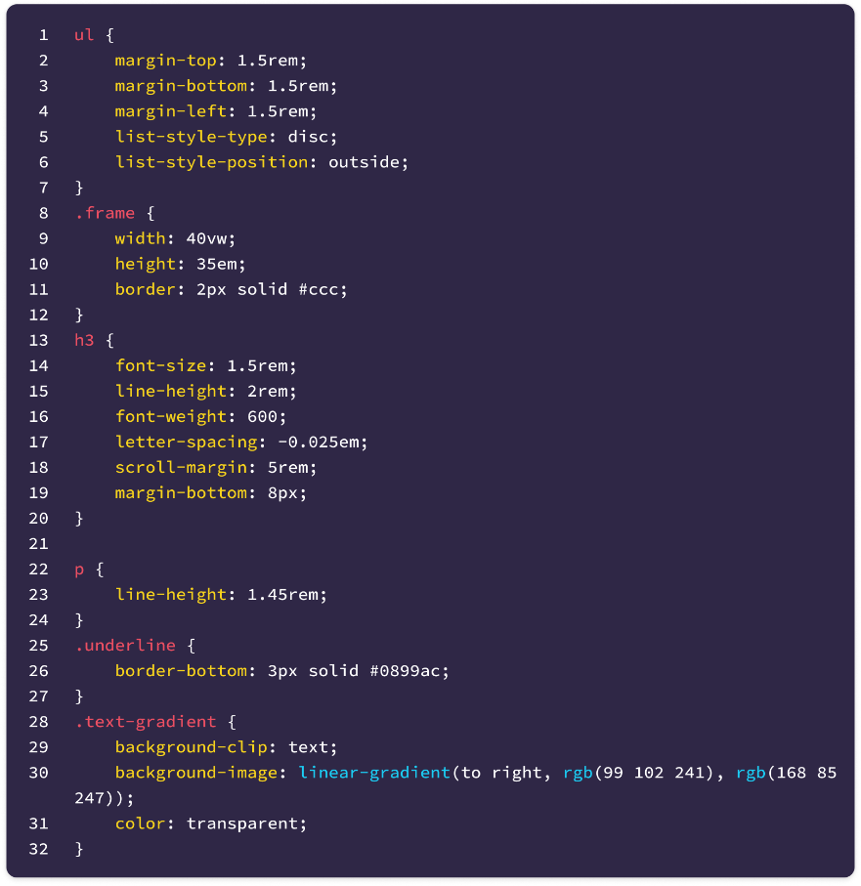

Slide 7



Slide 8

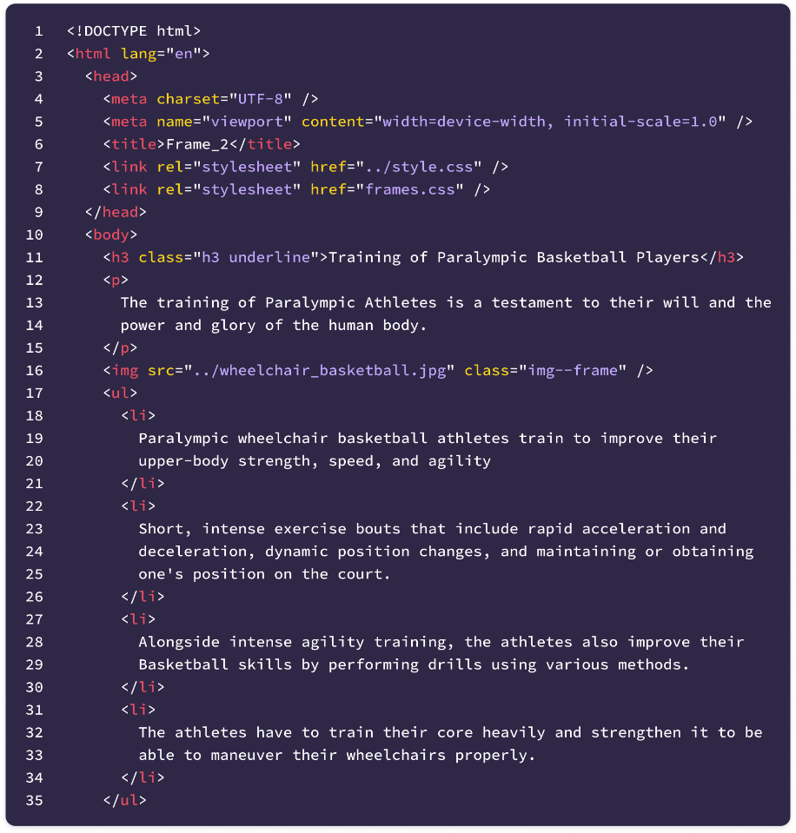
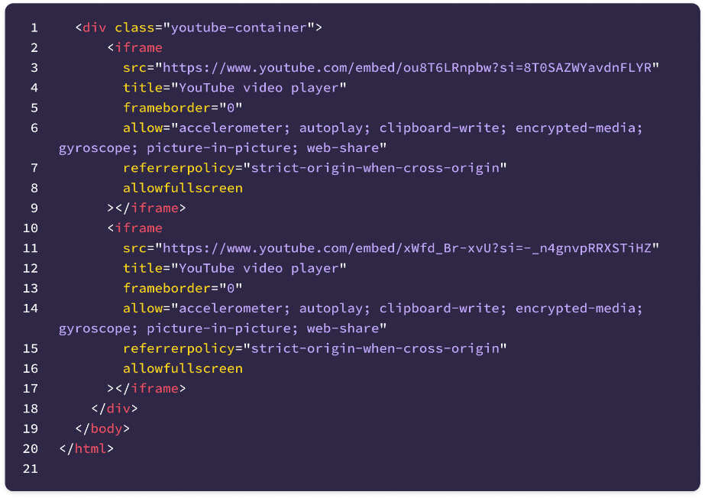

Slide 9



Slide 10

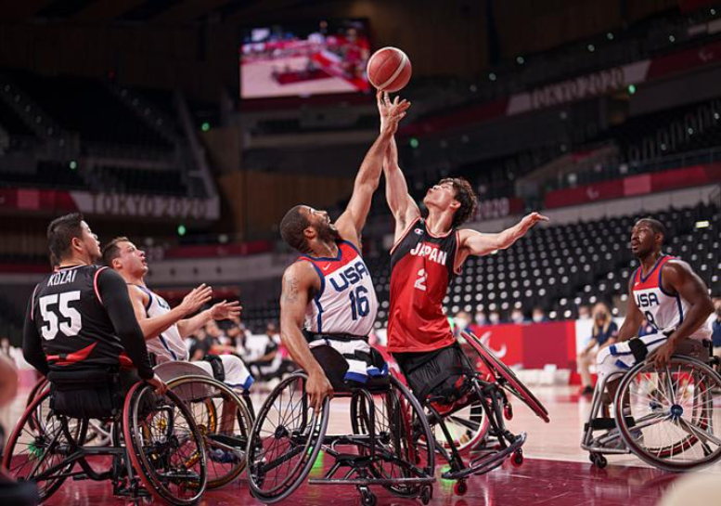
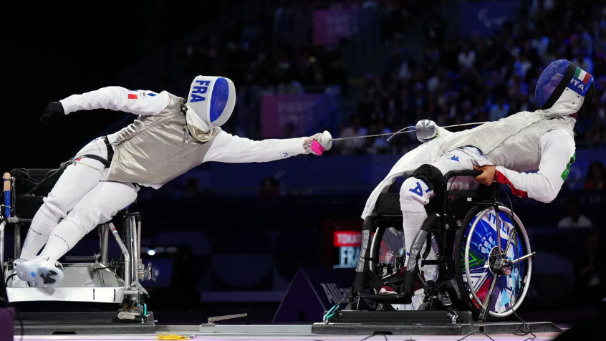
wheelchair_basketball.jpg
inclusivity.webp

Slide 11
Original Code
Original code for this project can be found at https://github.com/JayanAXHF/CA-IDR

Slide 12

English IDR
11

Slide 13


